Slide 2
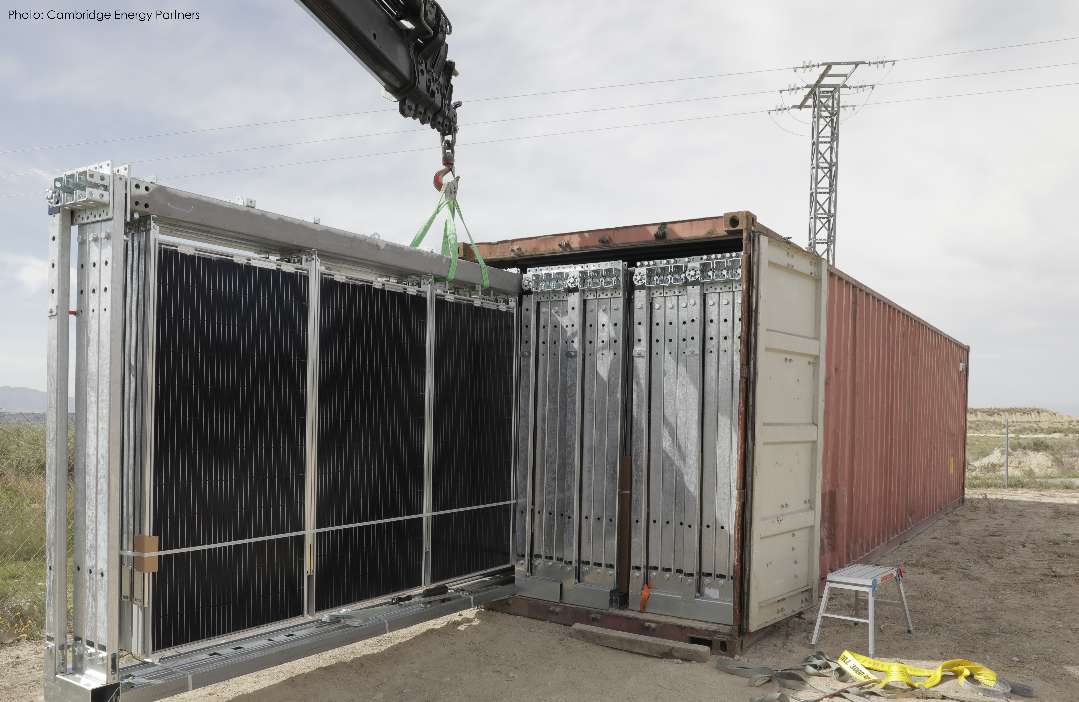
Title page

Slide 3
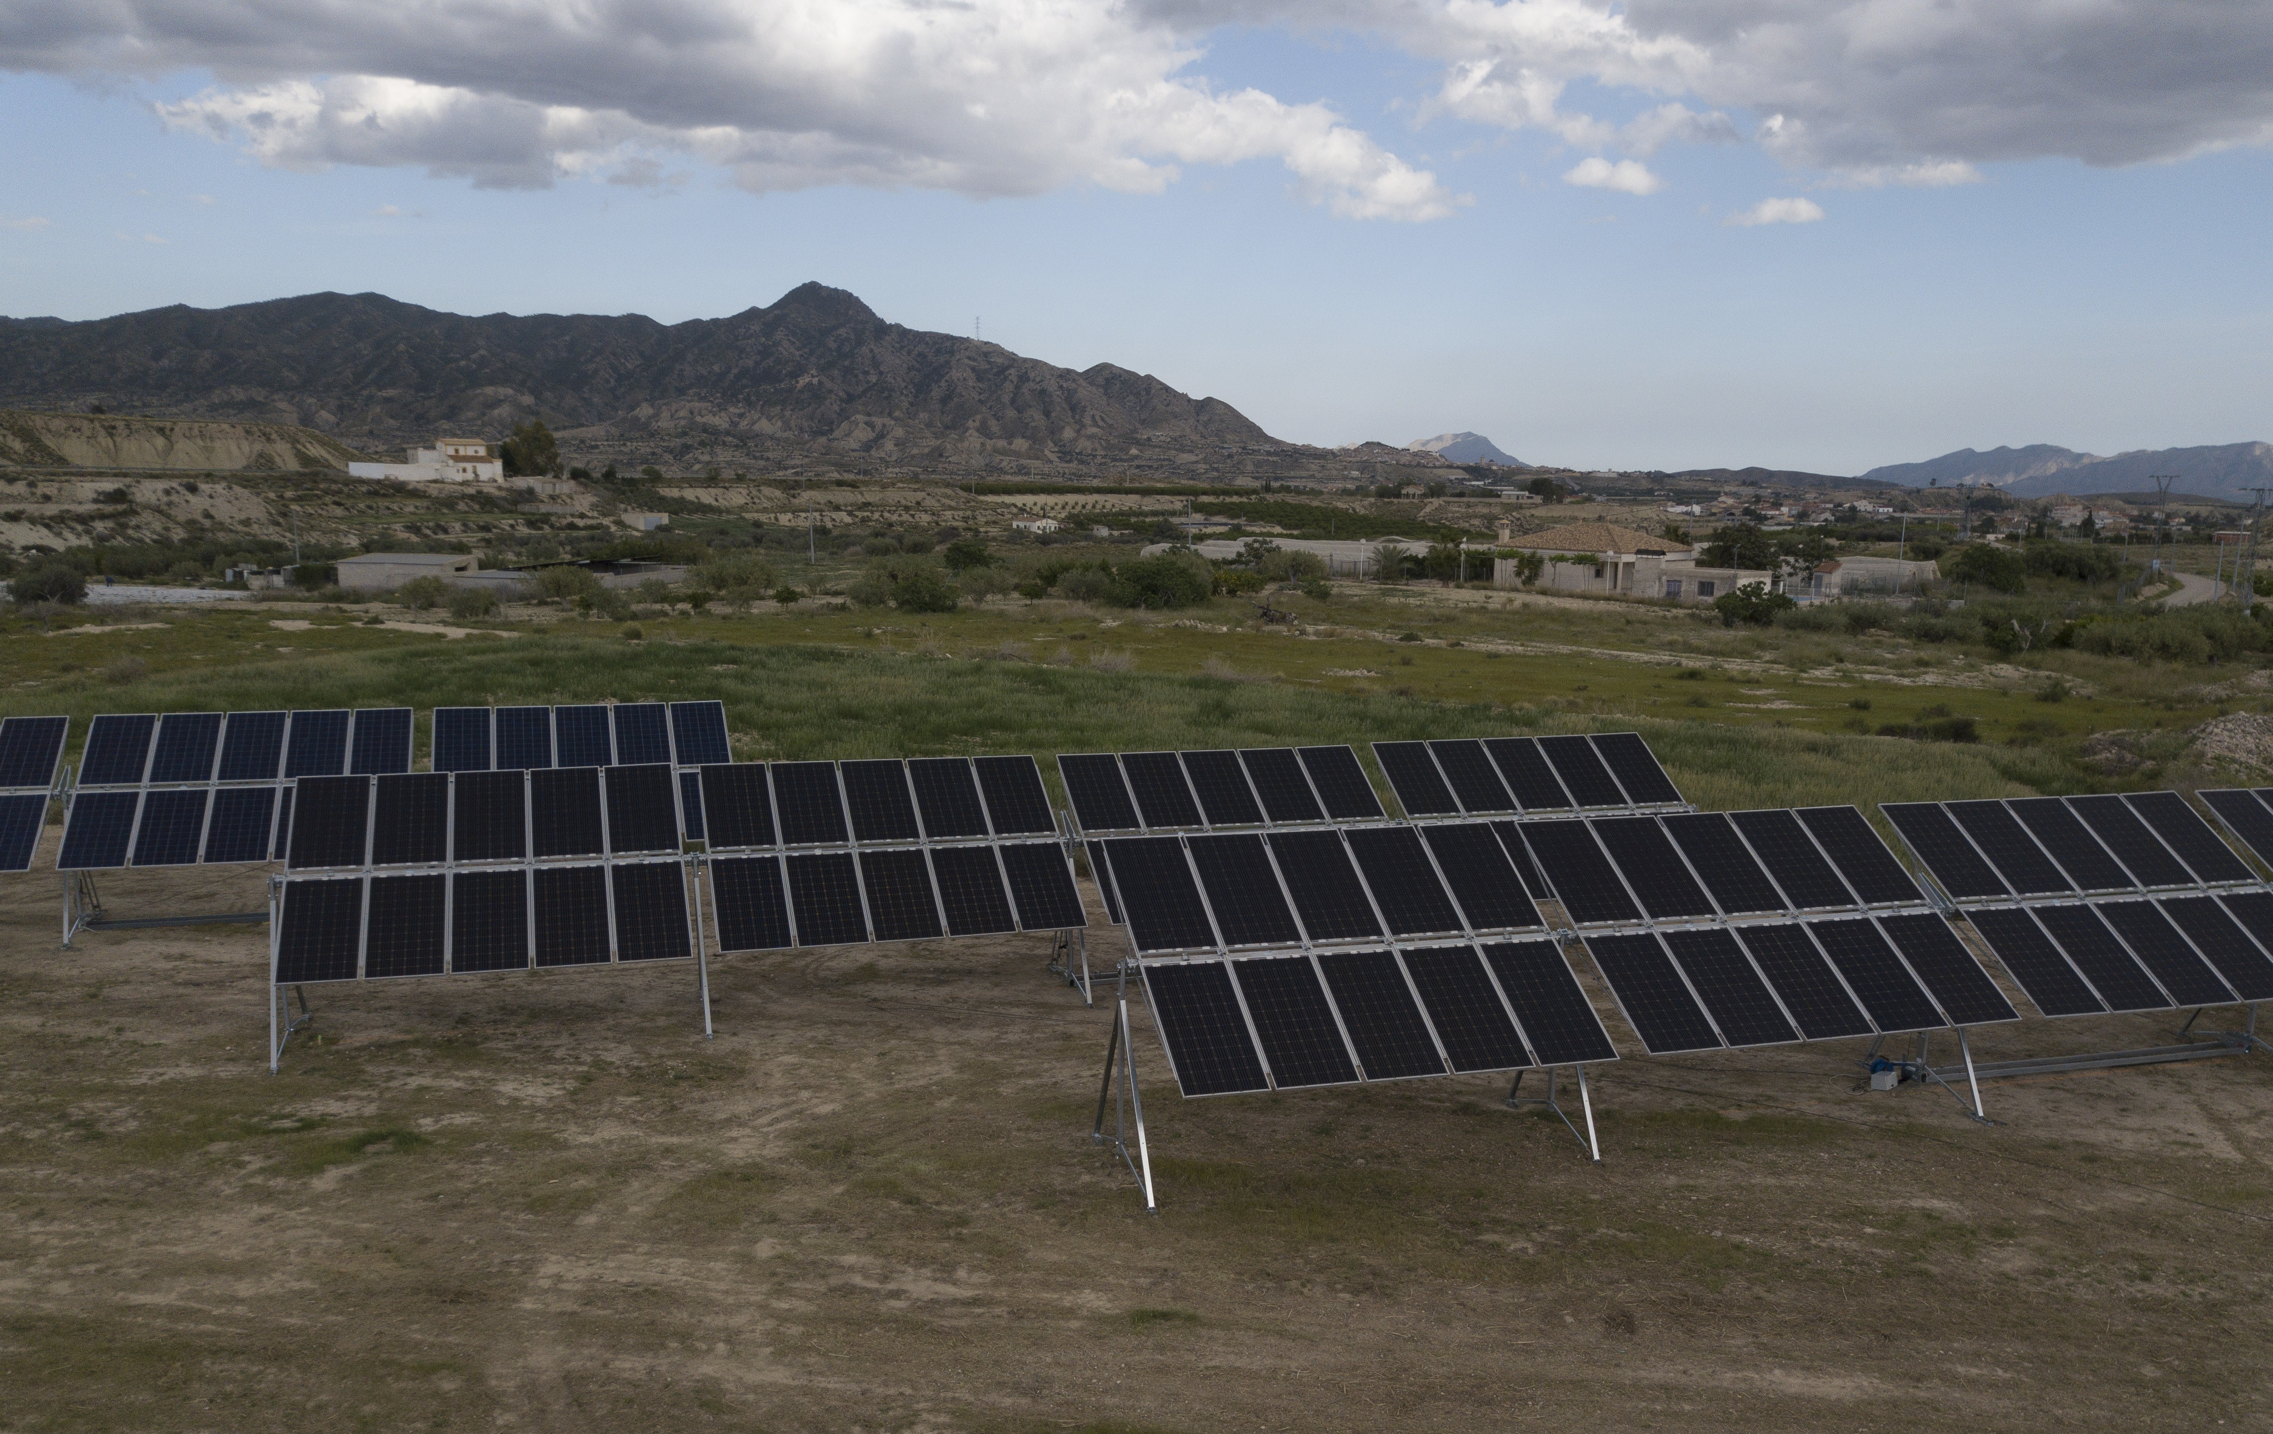
Solar made simple
A power solution that reduces power costs while ancreasing power independence.

Slide 8
